Slide 1

STAFFING BEYOND 2022
DEMOGRAPHICS AND TALENT SHORTAGES TO SHAPE THE FUTURE
Dr. Ray Johnson, B.Sc.Ag., M.Sc.Ag., PhD
Managing Director,
Agricultural Appointments

Slide 2

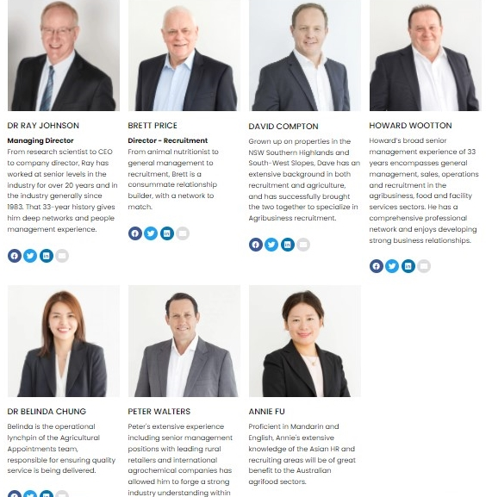
A leading agribusiness recruitment company for over 40 years
We are people who have worked in the agrifood industry during our careers
We support the agribusiness sector, including sponsoring and attending university career events
We publish regular Agribusiness Salary & Trend Reports that look at what’s happening on the people side of the industry

Slide 3
Today
Brief Introduction
Effect of COVID-19 on the Ag Jobs Market?
Trends that are shaping the talent pool
Summary

Slide 4
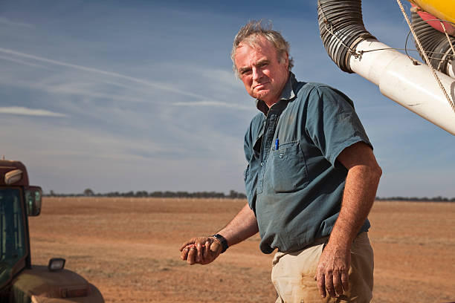
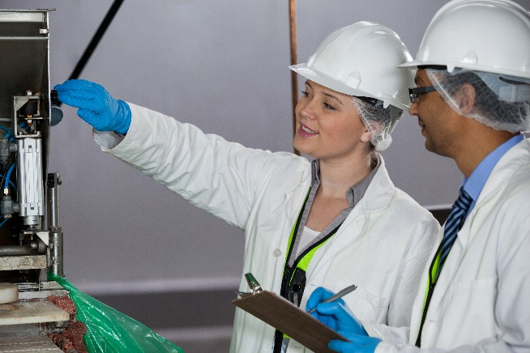
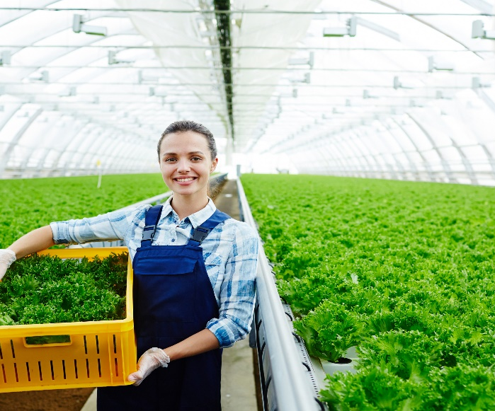
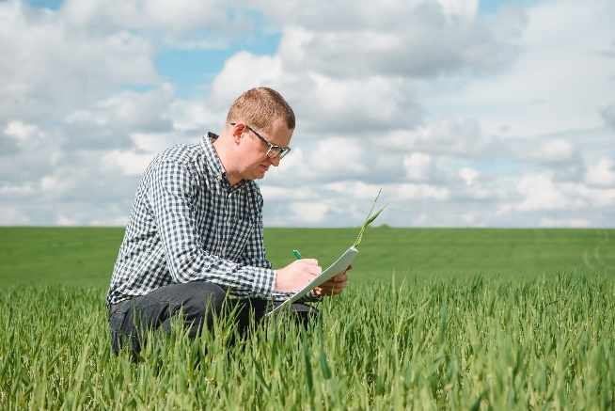
Myth that agriculture = Farming
Agriculture is the biggest employer in rural and regional Australia, employing around 300,000 people directly
The Australian agriculture industry is about the whole value chain, from on-farm production through to transport, manufacturing, marketing, finance, innovation, services, R&D, ag engineering, renewable energy, carbon capture, etc
There are more than 1.6 million people employed across this supply chain

Slide 5
Evidence that agricultural production is on an increasing trajectory

Slide 6
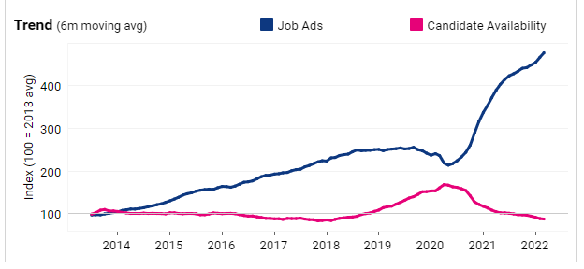
There is increasing demand for agribusiness skilled people
(Source: Seek internal correspondence May 2022)

Slide 7
Workforce capacity looms as the sector’s most significant issue
Australian agriculture sector faces a near critical skills shortage

Slide 8
Trends That Are Shaping the Talent Pool
The Ascendency of Millennials is Now Complete
The Battle to Attract Young People to a Career in Agriculture
Remuneration – a Barrier to Attracting Future Talent to Agribusiness
Changes in the gender ratio of agricultural graduates

Slide 9
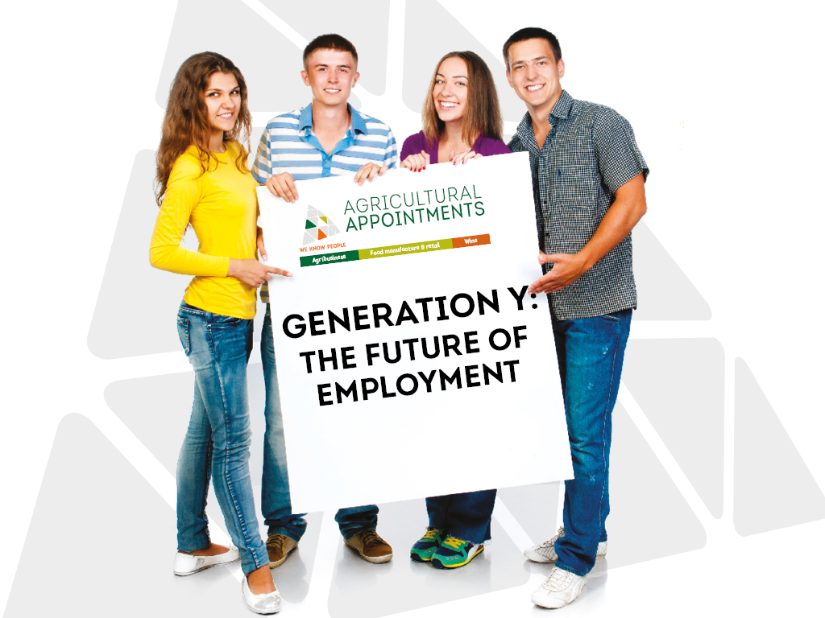
Trends That Are Shaping the Talent Pool
#1 - The Ascendency of Millennials is Now Complete
Australia is experiencing a rapidly ageing workforce and is now undergoing the largest generational shift in 60 years,
  Baby Boomers finally retire after holding onto jobs beyond the traditional retirement timeframe;
This transition creates a considerable challenge for business.
How to manage the greatest transfer of organisational knowledge we’ve ever seen before?
McCrindle Report

Slide 10



A majority of employees are now Gen Ys
$$\$$$
%
%
Notes:
They’ll become the biggest proportion of workers in just five years, growing from 34% of the workforce now, to 42% by 2020.

Slide 11


Gen Y’s – who are they?
People born roughly between the years 1980 to the mid-1990’s (27-42 years of age)
Gen Y’s are the children and grandchildren of the Baby Boomers and the best-educated and most materially well provided generation ever
Gen Y’s are not the same as any other generations before them, they are more digital and technology savvy, have important social and environmental concerns, do not appear as career-driven as BB’s, harder to get into regional jobs, expect higher salaries, will change jobs regularly
Notes:
We often hear people discuss the generational differences in work ethic and attitudes
But the fact is that by 2020, the majority of employees will be Gen Ys. So we need to engage and retain them.
Today, I’m going to talk about why you should care about Gen Ys, and share two case studies of two businesses, run by people just like us, who successfully engage and retain Gen Ys.

Slide 12


Slide 13

Agribusinesses that ignore these differences
Will find it harder to attract people to their business
Will have a higher staff turnover as millennials move on to businesses more aligned to their wishes
Notes:
Gen Ys will be a critical part of our workforce in the near future
Agribusiness will need to try even harder than many others to attract them to our regions and businesses
We’ll need to do it by offering competitive remuneration
Boosting that with developing career pathways supported by training
Creating cultures that accept that Gen Ys are different from our generation and fostering collaboration

Slide 14
Trends That Are Shaping the Talent Pool
#2 - The Battle to Attract Young People to a Career in Agriculture

Slide 15
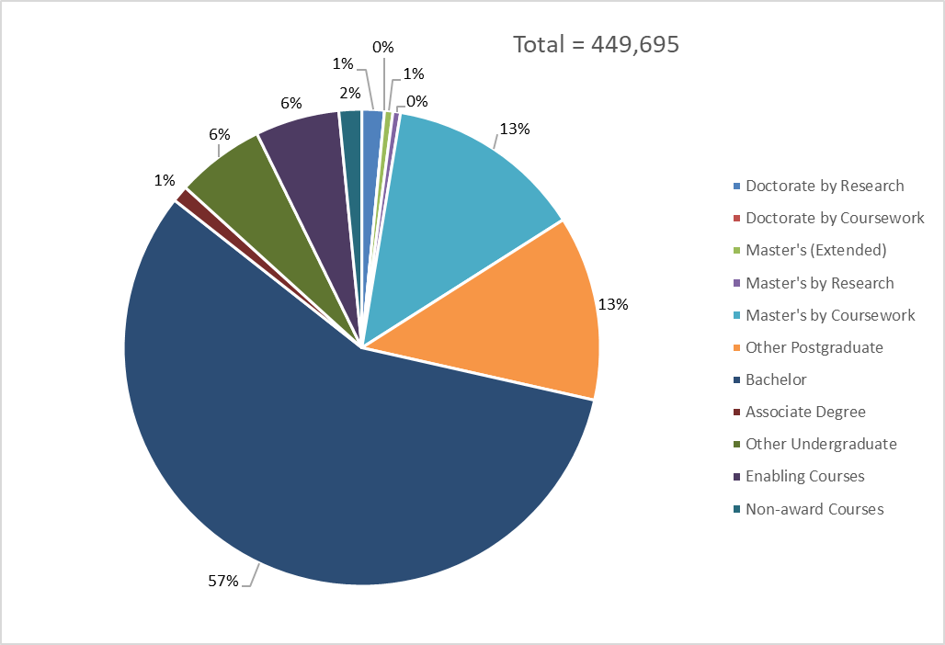
Commencing Domestic Students by Age Group and Broad Level of Course, Full Year 2020
Australian Government Department of Education, Skills and Employment https://www.dese.gov.au/higher-education-statistics/student-data/selected-higher-education-statistics-2020-student-data-0

Slide 16
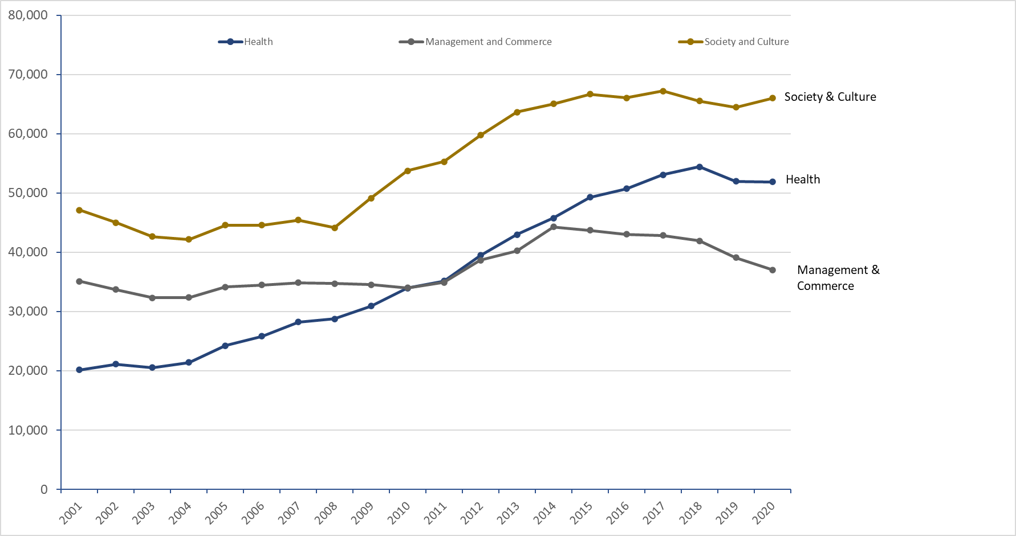
Bachelor Degree Commencing Domestic Students by Field of Education 2001-2020

Slide 17
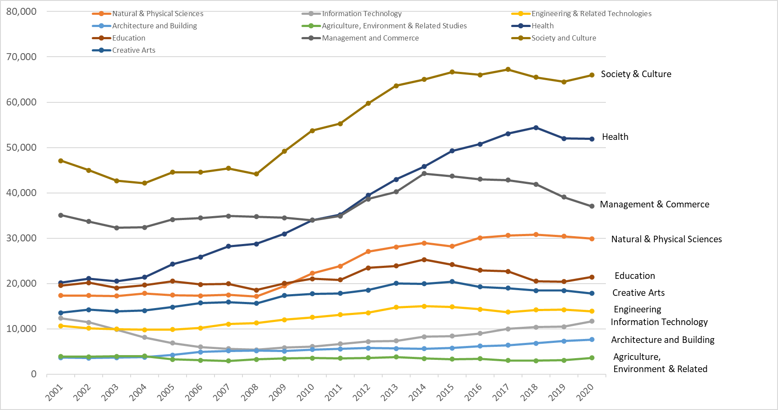
Bachelor Degree Commencing Domestic Students by Field of Education 2001-2020

Slide 18
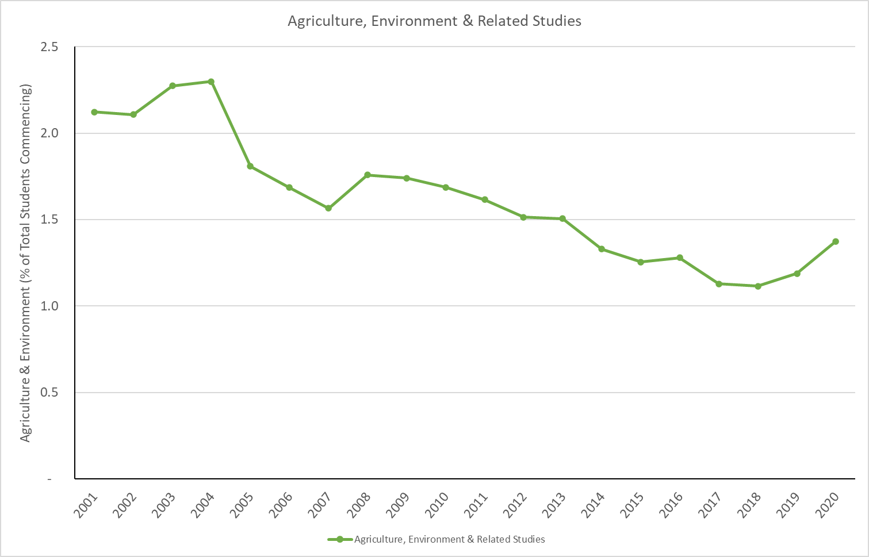
Agriculture & Environment Proportion of Total Bachelor Degree Commencing Domestic Students by Field of Education 2001-2020
Of the 260,000 domestic students who selected an undergraduate degree course in 2020
  3,613 were in this Agriculture, Environment & Related Studies category
This is 1.4% of the total students
My estimate is that around 30% of this category is Ag Science, giving about 1,084 who opted for agriculture per se, 0.42% of the total

Slide 19
Is there any evidence of intervention strategies to arrest this decline in students enrolling in Ag Science?
Agriculture is not competing effectively for the hearts and minds of young school children
The skills shortage in Australian agriculture has been the subject of a number of reports and Federal and State Parliamentary Enquiries
Over the twenty-year period from 2001 to 2021 the hard data shows that there is absolutely no evidence that there has been any effective intervention strategies to arrest this decline in students enrolling in ag science

Slide 20
Trends That Are Shaping the Talent Pool
#3 - Remuneration – a Barrier to Attracting Future Talent to Agribusiness

Slide 21
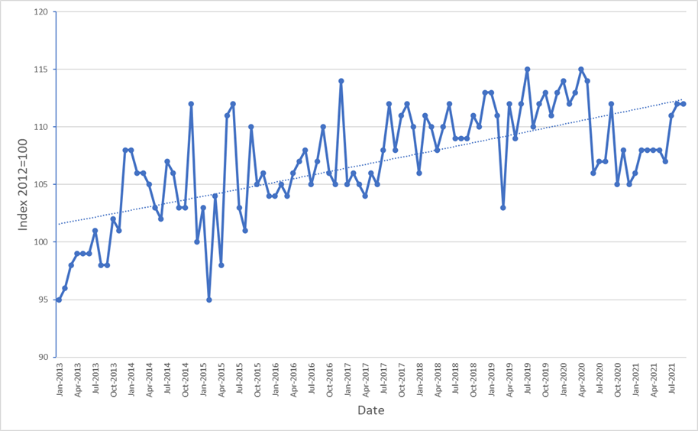
Average advertised relative salary levels in the Seek Farming jobs category from 2012 to September 2021 (Index is 100=2012).
Since 2012 the Seek average advertised salary level has risen by approximately 15% to the end of 2019, giving an average salary increase of 2%/ annum
This rate of salary increase is only just keeping up with the average inflation of around 2%/annum, indicating that real agricultural and farming salaries in Australia have not actually increased over the last decade when adjusted for inflation

Slide 22
There will need to be greater flexibility in remuneration levels to attract talent to the agribusiness sector

Slide 23
Trends That Are Shaping the Talent Pool
#4 - Changes in the gender ratio of Ag graduates

Slide 24
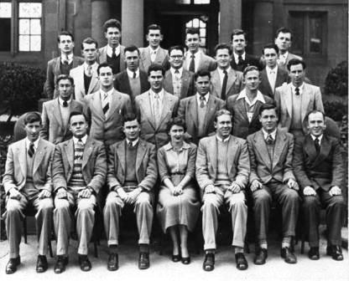
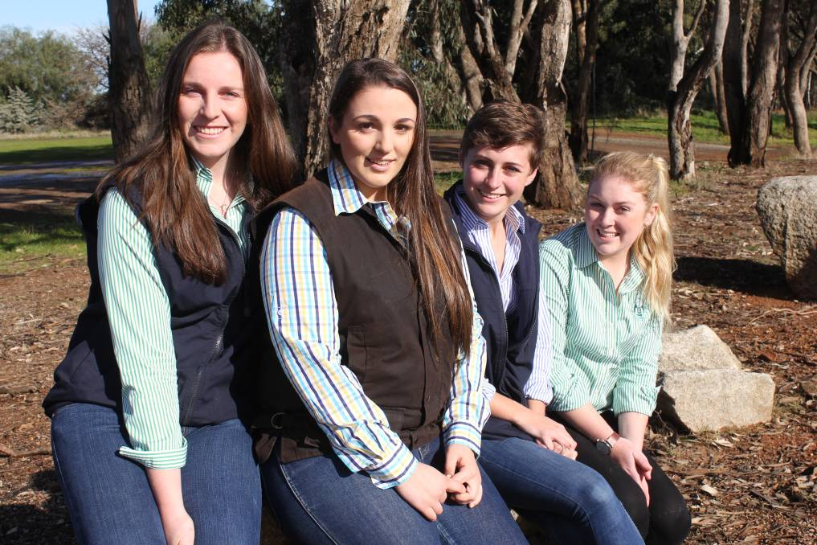
Vinleigh Johnson was the only woman in final year Agriculture in 1954
Now more than 50% of all university agricultural science and veterinary science graduates are women

Slide 25
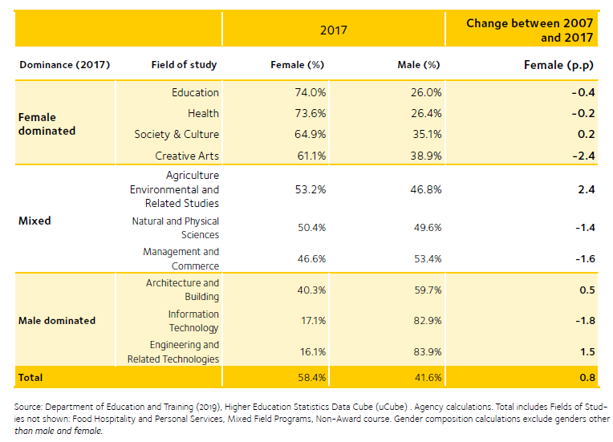
Gender composition of domestic enrolments by field of study, 2007-2017
https://www.wgea.gov.au/publications/higher-education-enrolments-and-graduate-labour-market-statistics#enrolments

Slide 26
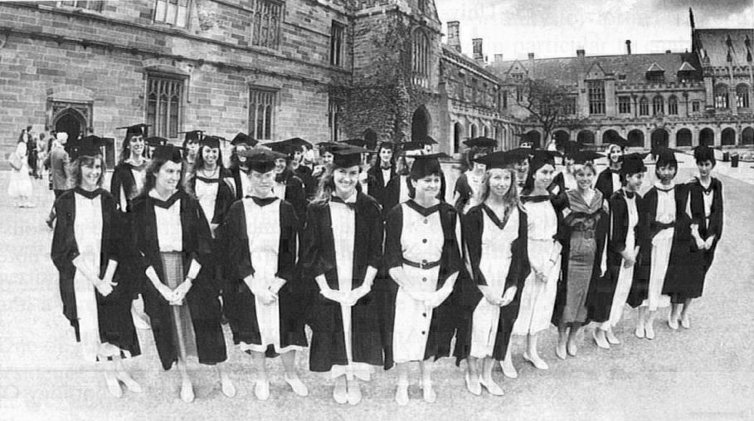
1989 – photo of 39 women who received their Bachelor of Veterinary Science degrees in 1989, the first year women out-numbered men

Slide 27
Placements Across All Roles Over the last Five Years
(Agricultural Appointments, internal data, 2017-2022

Slide 28
Gender Balance of Placements Across All Roles Over the last Five Years (Agricultural Appointments, internal data, 2017-2022)
%
%

Slide 29
There is a dysfunction between the increase in women undergoing university training in agricultural science and employment in the agribusiness sector
It is an important issue for the sector to address as it represents a serious loss of talent

Slide 30
Summary
It appears that we have entered a new era of talent shortages in the ag industry– severe skills shortages
Concurrently there is a severe reduction in candidate availability – getting worse, not better
Key Trends
    1. We are in the midst of a major generational change in the workforce, as baby boomers retire and Gen Ys become dominant - disruption
    2. Agriculture is not effectively competing in the battle to attract young people into ag career pathways – no evidence of significant intervention to change this situation over the last 20 years
    3. Remuneration levels are just keeping up with inflation, so CPI adjusted salaries are showing no real growth – need to compete
    4. There is now a healthy gender balance in ag students university enrolments, but this is not being reflected in female placements into jobs across the industry according to our information – loss of talent

Slide 31
Summary
It appears that we have entered a new era of talent shortages in the ag industry– severe skills shortages
Concurrently there is a severe reduction in candidate availability – getting worse, not better
Key Trends
  We are in the midst of a major generational change in the workforce, as baby boomers retire and Gen Ys become dominant - disruption
  Agriculture is not effectively competing in the battle to attract young people into ag career pathways – no evidence of significant intervention to change this situation over the last 20 years
  Remuneration levels are just keeping up with inflation, so CPI adjusted salaries are showing no real growth – need to compete
  There is now a healthy gender balance in ag students university enrolments, but this is not being reflected in female placements into jobs across the industry according to our information – loss of talent

Slide 32
Thank you

